Slide 1
PSYCHOSOCIAL DISABILITY & NDIS

Slide 2
Psychosocial Disability & NDIS
Psychosocial disability describes a disability that arises from a mental health condition
Not everyone who has a mental health condition will have a psychosocial disability
People with a disability as a result of their mental health condition may qualify for the NDIS

Slide 3
Psychosocial Disability Challenges
Providing evidence for psychosocial disability
Planners experience and knowledge
Support needs fluctuate
Support can be unwanted
Housing options
Notes:
There are a number of specific challenges relating to psychosocial disability and the NDIS. Firstly, there have been frustrations by clinicians who struggle to evidence the permanence and significance eligibility criteria for people with a psychosocial disability. Secondly, NDIS planners are often not experienced or competent in working with this demographic and hence do not understand their specific support needs. Alongside this planning for care has been challenging due to both the fluctuation in need for support from one day to the next as well as the fact that often people with a psychosocial disability often refuse or deny the fact that they require support. Finally housing support for those people with complex behaviours as a result of their psychosocial disability and who struggle to live with others have found it difficult to find age appropriate accommodation and are getting stuck in hospitals or inappropriate environments.

Slide 4
NDIS Act and psychosocial disability
A person meets the disability requirements if:
The person has a disability that is attributable to one or more...impairments attributable to a psychiatric condition; AND
The impairment/s are, or are likely to be permanent; AND
The impairments result in substantially reduced…psychosocial functioning in undertaking, one or more of the following activities: communication; social interaction; learning; mobility; self-care; self-management; AND;
The impairment/s affect the person’s capacity for social or economic participation; AND
The person is likely to require support under the NDIS for the person’s lifetime.
Notes:
Note: Acknowledge the language principles are the same for all disabilities and that the focus needs to be on the functional impairment.

Slide 5
NDIS Act and completing the ARF
Schizophrenia
Psychiatric Condition
Impairment
Paranoia
Difficulty leaving the house and going to public places
Psychosocial Functioning
Unable to complete weekly shopping
Social or Economic Participation
Notes:
Let’s look at an example of the Act. To evidence disability we need to note the impairment is attributed to a psychiatric condition. In this example the impairment linked to the psychiatric condition is a cognitive impairment which could include deficits such as difficulties in self initiation or with problem solving.
We can then look at the impact of the impairment (cognition) on the person’s psychosocial functioning, so how does it impact on day to day life. Examples could include that a person might have difficulty leaving the house and going into public places. In the diagram the psychosocial functioning impact is that the person is unable to complete weekly shopping. The NDIS legislation also requires an understanding of how the impairment impacts on social and economic participation. The example here is that the person, due to his cognitive impairment a result of the psychiatric condition and limited ability to self initiate is unable to participate in a volunteer or work program.

Slide 6
NDIA - Mental Health and NDIS
NDIA Website
https://www.ndis.gov.au/understanding/how-ndis-works/mental-health-and-ndis
What is psychosocial disability?
Accessing the NDIS
New Evidence of Psychosocial Disability Form (Jan 20)
What is recovery?
What supports will the NDIS fund?
Factsheets and resources

Slide 7
DHHS - Information on psychosocial disability
E-Learning modules and resources: https://www.mhpod.gov.au/
NDIS related training and resources (e.g. information and tools)
Ways of Working with the NDIS: A practice resource for clinical mental health services
NDIS information for mental health clinicians consisting of a range of practice advice, tip sheets and tools to assist clinicians to support participants across the NDIS pathway
NDIS Implementation Guide to assist health services to establish an effective operational interface with the NDIS

Slide 8
Internal - Victorian NDIS Mental Health Program Lead
Albury Wodonga Health | Stuart McIntosh | Stuart.McIntosh@awh.org.au
Alfred Health | Sujit Nimbkar | S.Nimbkar@alfred.org.au
Austin Health | Kristen Stanner | Kristen.Stanner@austin.org.au
Ballarat Health | Nikki Stiefel | Nikki.Stiefel@bhs.org.au
Barwon Health | Kavita Bhasin | KBHASIN@BarwonHealth.org.au
Bendigo Health | Nicole Davis | NDavis@bendigohealth.org.au
Eastern Health | Bronwyn Williams | Bronwyn.Williams@easternhealth.org.au
Forensicare | Grant Burkitt | grant.burkitt@forensicare.vic.gov.au
Goulburn Valley Health | Pam Ewert | Pam.Ewert@gvhealth.org.au
Latrobe Regional Hospital | Cayte Hoppner | choppner@lrh.com.au
Melbourne Health | Fiona Jeal | Fiona.Jeal@mh.org.au
Mercy Health | Maryann Croatto | mcroatto@mercy.com.au
Mildura Base Hospital | David Kirby | KirbyD@ramsayhealth.com.au
Monash Health | Susan Brunton | susan.brunton@monashhealth.org
Peninsula Health | Shol Blustein | shol.blustein@impactco.com.au
South West Health | Nicholas Place | NPlace@swh.net.au
St Vincent’s Hospital | Rachael Starbuck/ Tania Nicholls | Rachael.STARBUCK@svha.org.au tania.nicholls@svha.org.au
Notes:
This table is relevant for Victorian audiences only. Please delete if not applicable.

Slide 9
External - Information on psychosocial disability
Reimagine: Mental Health and the NDIS
Tandem: Mental Health & the NDIS (NDIS consultant available)
VMIAC: NDIS – Support appeals and reviews
Embark: NDIA & Health Funded Resources for Psychosocial Disability
Notes:
Useful resources for participants and supporters.

Slide 10
Resources - evidence of psychosocial disability
Aftercare Australia
National NGO mental health service
Research and relationships across government and social services
NDIS registered - services and resources specifically to psychosocial disability
Completing the NDIS process for your patients video
Providing Evidence of Psychological Disability resource
Notes:
Expansion of last listed resource appears on next slide.

Slide 11
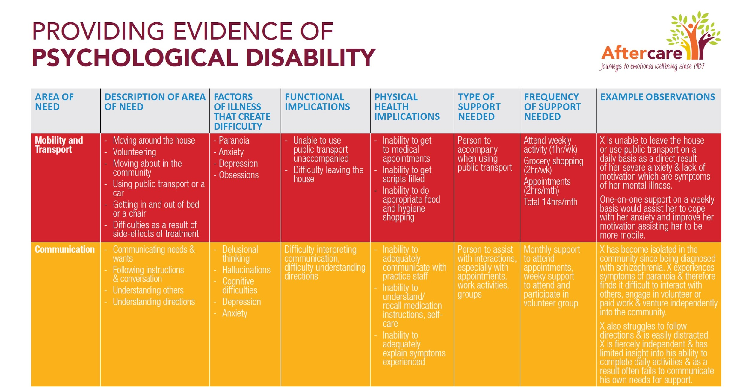
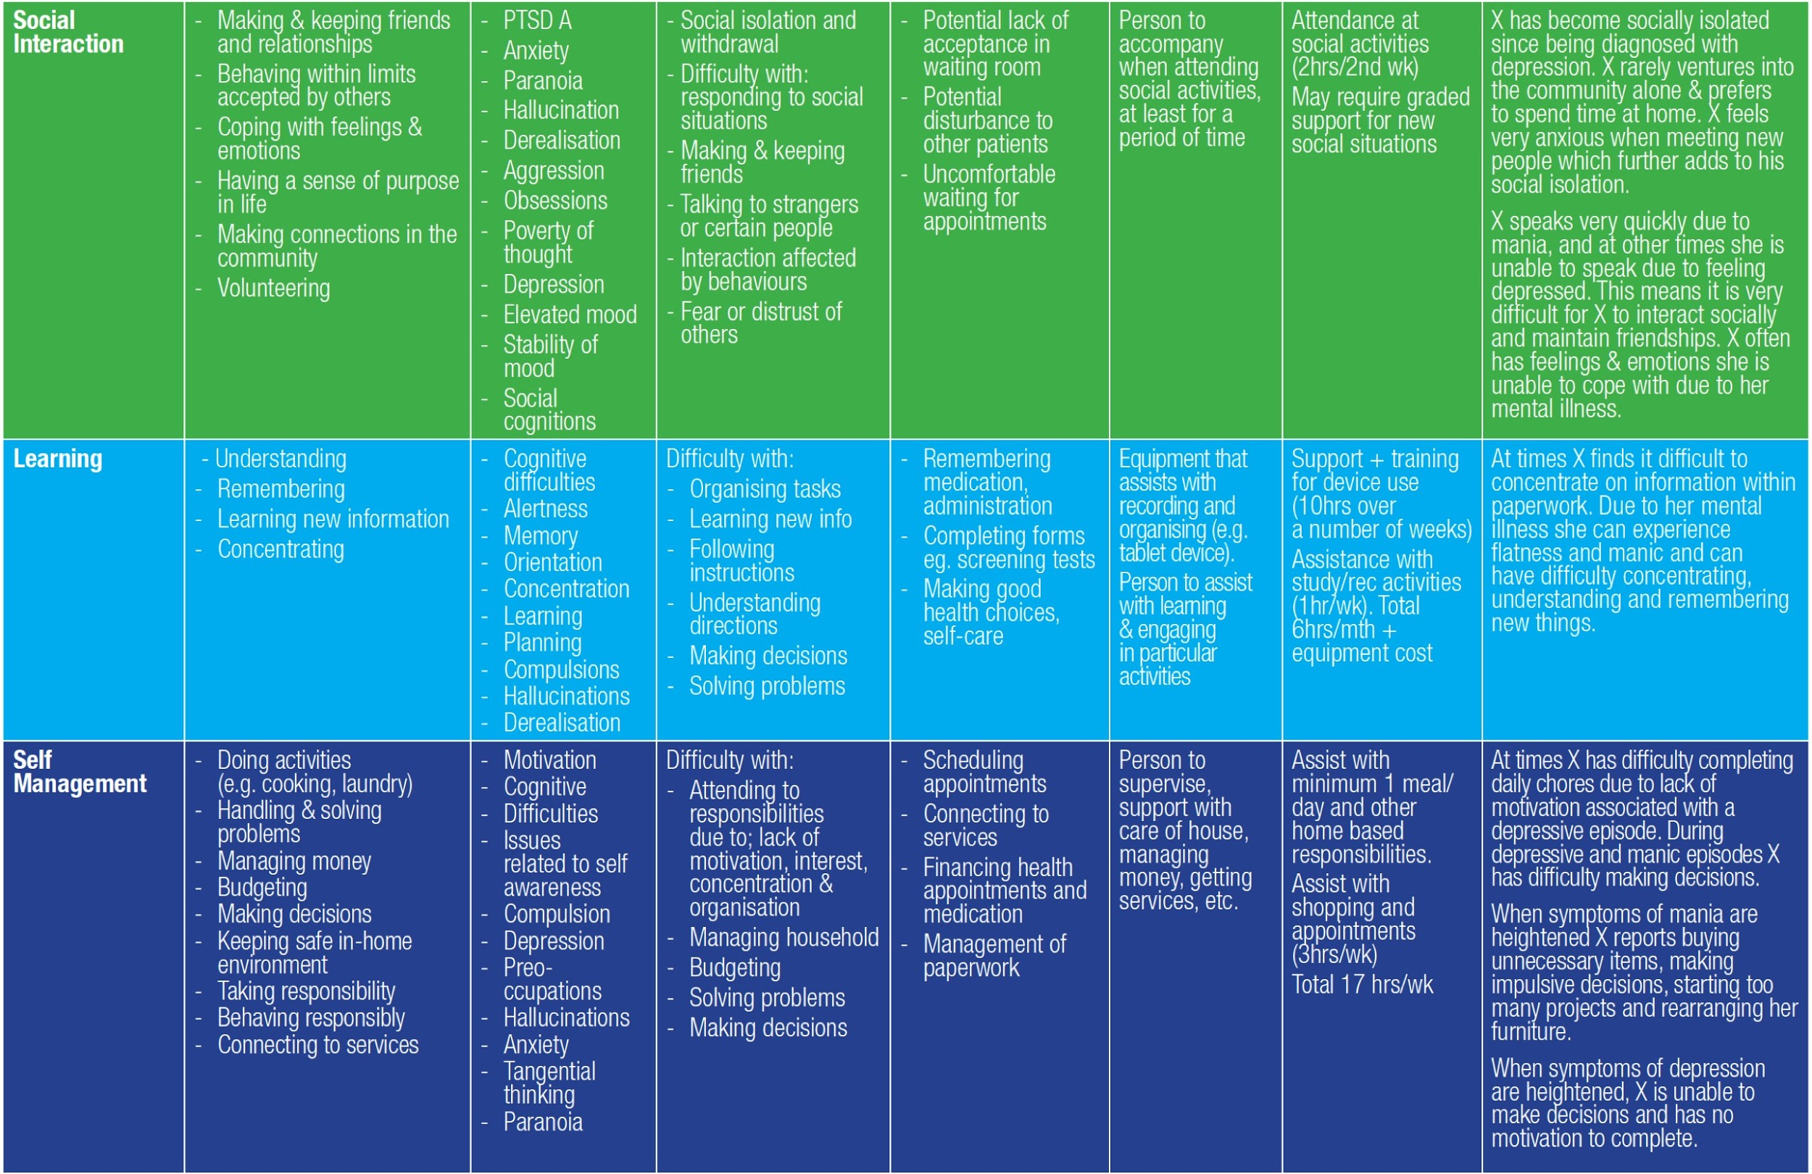
Notes:
Consider printing off this resource (link on previous slide) in order to provide each attendee with a copy and talk through an example.

Slide 12
Summary
Psychosocial disability can be a primary OR secondary disability - relevant for all health staff to understand
Apply NDIS principles of ‘Functional Impairment’ and ‘Social and Community Participation’ to determine if participant meets eligibility
Know what NDIS supports and resources are available in your local health service and community
Refer to support coordinators and allied health teams that specifically work within mental health

